Slide 2
CERN openlab summer student lectures
Matteo Bunino, Maria Girone, Andrew Purcell

Slide 3













CERN openlab
CERN openlab is a unique public-private partnership.
We work to drive innovation in computing technologies.
We collaborate with leading technology companies (including Intel, Oracle, Siemens, Micron, Google).
We also work with other research laboratories (including Fermilab and INFN).
Education and training are important aspects of our work.
Over 2000 applicants for this year’s CERN openlab summer student programme.
30 students selected from 21 different countries.
More info on our website: openlab.cern
Follow us on Twitter/Facebook: @CERNopenlab.

Slide 4
Lectures from the main programme
Particularly recommended to openlab students
From Raw Data to Physics Results
Paul James Laycock
Main Auditorium (500/1-001)
11:35-12:30, 28 June
09:15-10:10, 29 June
10:25-11:20, 30 June
Foundation of Statistics
Glen Cowan
Main Auditorium (500/1-001)
09:15-10:10, 4 July
10:25-11:20, 5 July
09:15-10:10, 6 July
11:35-12:30, 7 July
Notes:
Webcast available for

Slide 5
Openlab lecture programme
Based on openlab pillars. In-person for openlab students, webcast available for the others.
Welcome and introduction to CERN
Alberto Di Meglio, Maria Girone, Anna Cook
IT Amphitheatre (31/3-004)
14:00-15:00, 4 July
Tackling computer challenges at CERN
Alessandro Di Girolamo, Maria Girone
IT Amphitheatre (31/3-004)
15:00-16:00, 4 July
DAQ-filtering data from 50 TB/s to 1GB/s
Flavio Pisani
IT Amphitheatre (31/3-004)
14:00-16:00, 10 July
Computer Security: Past, Present & Future
Stefan Lueders
IT Amphitheatre (31/3-004)
14:00-16:00, 11 July
Notes:
Webcast available for

Slide 6
Openlab lecture programme (2)
AI and High-performance Computing (HPC).
Introduction to Machine Learning and Deep Learning
Michael Kagan
IT Amphitheatre (31/3-004)
14:00-16:30, 13 July
Graph Neural Networks: From fundamentals to Physics application
Ilias Tsaklidis
IT Amphitheatre (31/3-004)
14:00-16:00, 17 July
Hyperparameter Optimization for Deep Learning Models Using High Performance Computing
Eric Wulff
IT Amphitheatre (31/3-004)
14:00-16:00, 18 July
Reinforcement learning and its applications at CERN
Matteo Bunino
IT Amphitheatre (31/3-004)
14:00-15:30, 20 July

Slide 7
Openlab lecture programme (3)
Quantum computing.
Basics of quantum computing (theory)
Alice Barthe
BE Auditorium Meyrin (6/2-024)
14:00-15:30, 27 July
Basics of quantum computing (practice)
Su Yeon Chang
BE Auditorium Meyrin (6/2-024)
15:30-17:00, 27 July
Applications of Quantum Computing: CERN use case, Quantum Machine Learning and optimization
Carla Sophie Rieger
IT Amphitheatre (31/3-004)
14:00-15:30, 31 July
Quantum Kernel Methods (hands-on on Quask)
Francesco Di Marcantonio, Roman Wixinger
IT Amphitheatre (31/3-004)
15:30-16:00, 31 July

Slide 8
Openlab lecture programme (4)
Advanced programming techniques.
GPU programming
Stephan Hageboeck
IT Amphitheatre (31/3-004)
14:00-16:00, 1 August
Best practices: the theoretical and practical underpinnings of writing code that is less bad
Axel Naumann
IT Amphitheatre (31/3-004)
14:00-15:30, 3 August

Slide 9
Openlab lecture programme (5)
Digital twins and advanced storage solutions.
Agent-based modeling: BioDynaMo
Lukas Breitwieser
IT Amphitheatre (31/3-004)
14:00-16:00, 25 July
Digital twins and their application at CERN
Ilaria Luise, Alexander Zoechbauer, Kalliopi Tsolaki
IT Amphitheatre (31/3-004)
14:00-16:00, 7 August
Highly durable and dense data storage through synthetic DNA
Raja Appuswamy
IT Amphitheatre (31/3-004)
14:00-16:00, 8 August
More info on the lectures on Indico:
https://indico.cern.ch/category/16988/

Slide 10


Evening lectures
Open to all summer students!
Introduction to quantum computing (1/2)
Ahmed Abdelmotteleb
IT Amphitheatre (31/3-004)
17:00-18:30, 25 July
Introduction to quantum computing (2/2)
Ahmed Abdelmotteleb
IT Amphitheatre (31/3-004)
17:00-18:30, 26 July
Movie night: “Particle Fever”
Mark Levinson
Main Auditorium (500/1-001)
19:30-22:00, 25 July

Slide 11
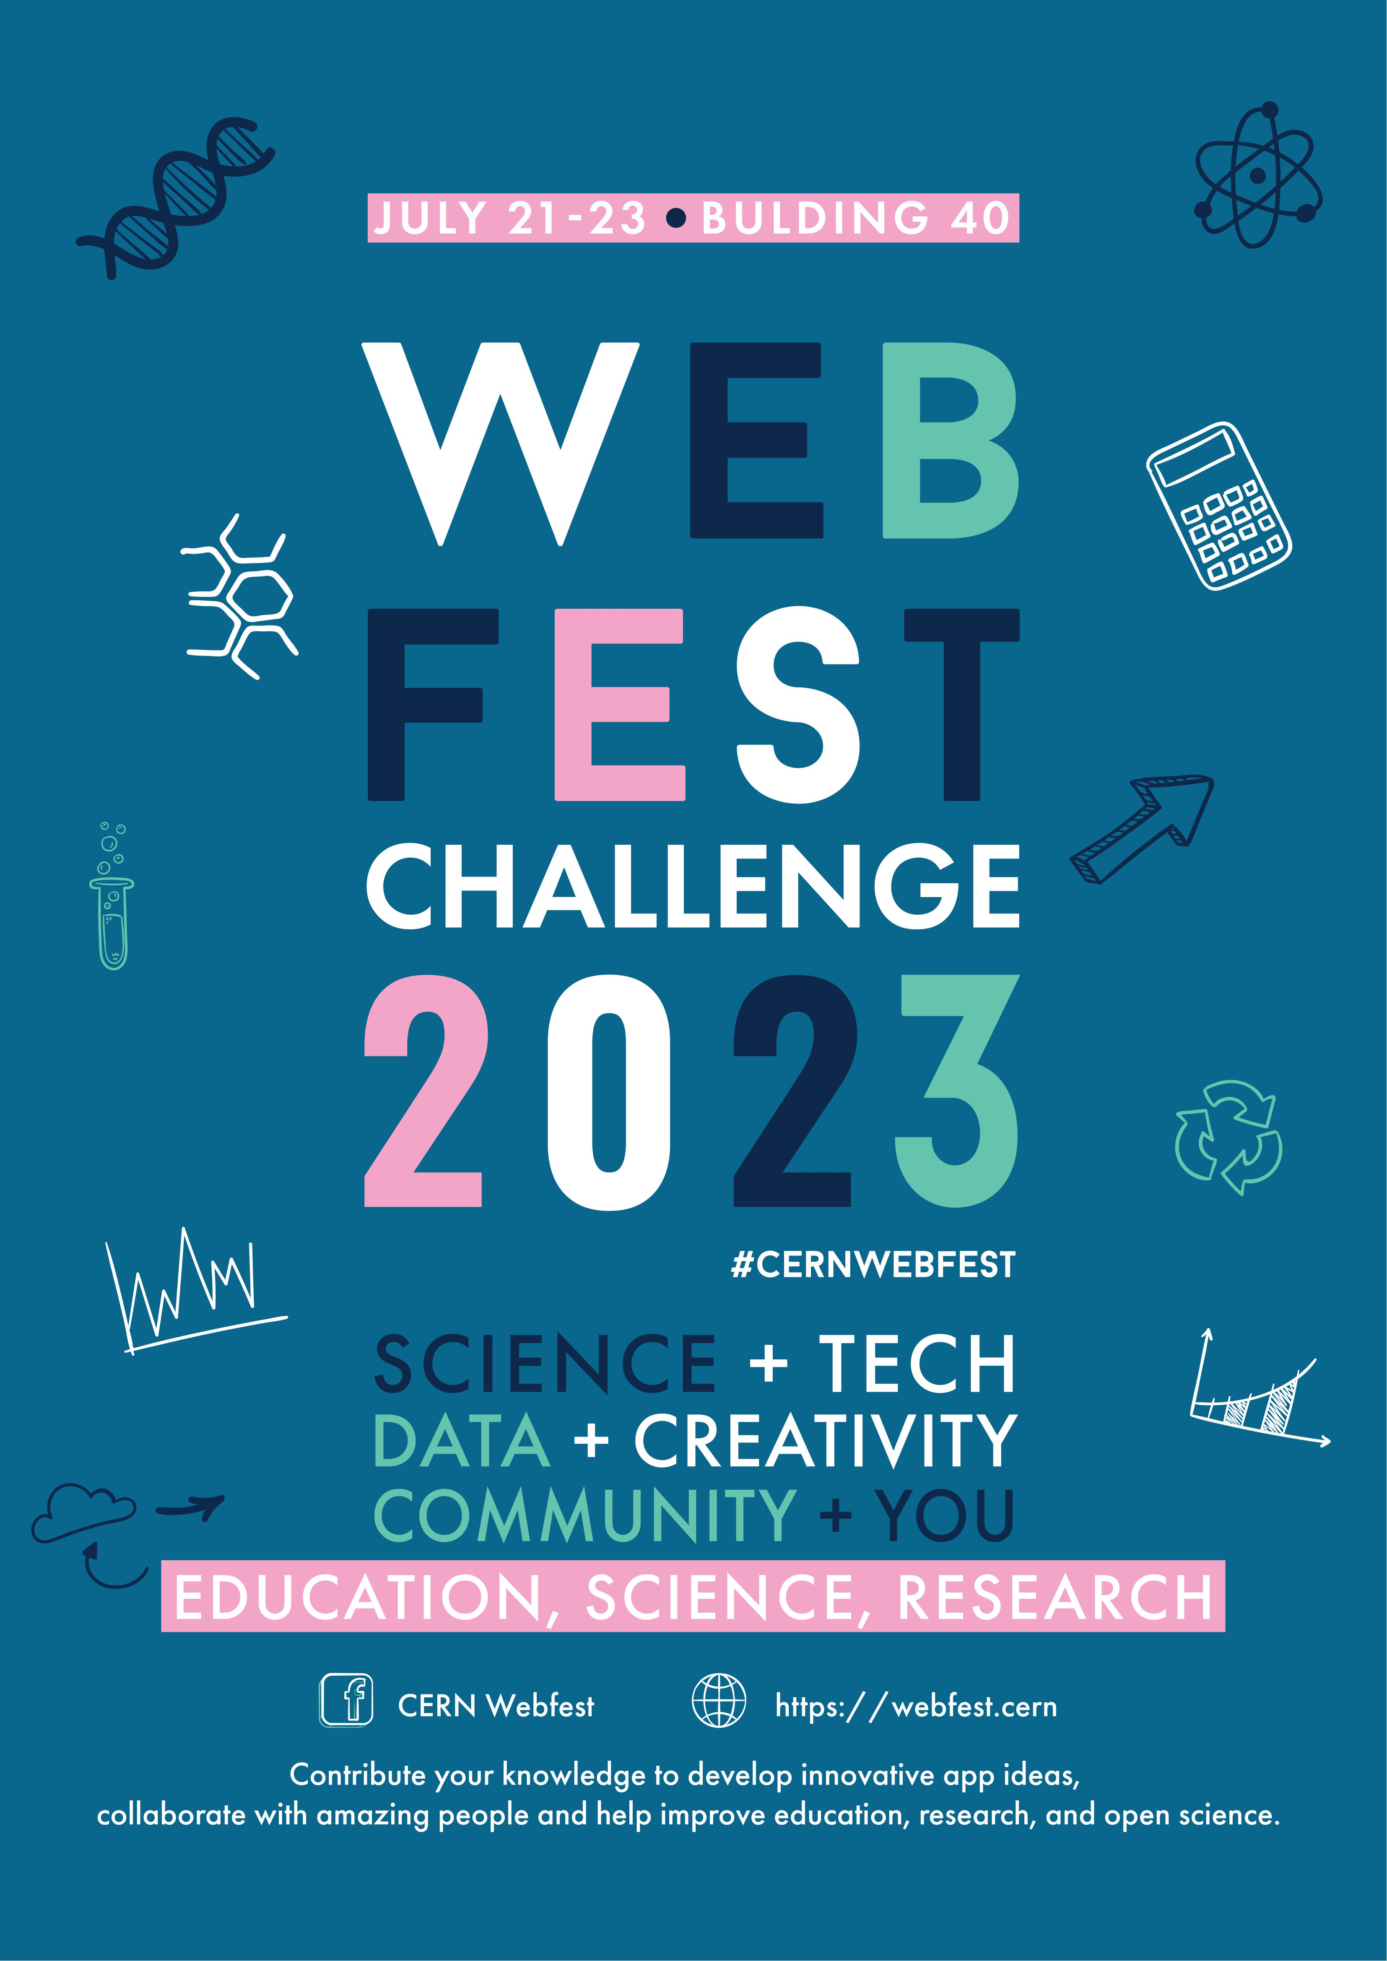
Lightning talks
Students work on projects over nine weeks, gaining hands-on experience with latest computing technologies.
5-minute presentations by each student, with prizes for best talks.
Split into two sessions: 15th and 16th of August.
Events will be online and open to all.
Webfest 2023
Running Friday 21 July – Sunday 23 July
Kick-off (Friday) in B40; Hacking day (Saturday) in R1; Closing and rewards (Sunday) in B40.
This year’s theme is education, science, research.
How CERN's cutting-edge technologies can be applied to science.
Open to all! Students, fellows, staff members…

